Slide 1
Midterm Solution

Slide 2
Lecture 6
Hash Tables

Slide 3
Hash Tables
A data structure that stores unordered items by mapping each item to a location in an array.
Each item has a key that is used to map to an index
The “hash function” computes an index in the array from the item’s key

Slide 4
Hash Tables
Each location in the array is called a bucket
Items in the table are added to a bucket calculated from the hash function

Slide 5
Hash Function
A common hash function uses the modulo operator
“10%3”
This evaluates to the integer remaining when dividing two numbers
The number you use in the modulus operation determines how many buckets you will have
i.e “key%20” will map keys to buckets indices 0 to 19

Slide 6
Collisions
A collision occurs when an item being inserted into a hash table maps to the same bucket as an existing item
Inadequate hashing functions create many collisions
A perfectly valid hash function can still be inadequate

Slide 7
Dealing With Collisions
We’ll cover two common ways of dealing with collisions in a hash table
Chaining
Open Addressing (Probing)
Both accomplish the same goal of allowing us to put multiple keys in the table that have the same hash

Slide 8
Chaining
Chaining handles hash table collisions by using a list for each bucket
Each list can store multiple items
Searching an item consists of:
Hash the key to find the bucket
Then search the list in that bucket for the item of interest
There is a performance cost for chaining when retrieving items

Slide 9
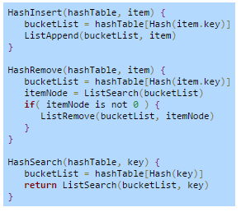
Chaining

Slide 10
Probing (Open Addressing)
Three common techniques:
Linear probing
Quadratic probing
Double hashing
All three techniques do these two basic steps:
Hash the key to determine which bucket to put the item in
If that bucket is occupied, continue probing buckets until an empty bucket is found
The difference is how they calculate which bucket to check next if the desired bucket is occupied

Slide 11
Probing
Linear Probing
The interval between probed buckets is fixed (usually set to 1 but can be larger)
Quadratic Probing
The interval between probed buckets increases quadratically (c1 and c2 are tunable constants)
Double Hashing
The interval between probed buckets is determined by another hash function

Slide 12
Linear Probing
One of the most common probing techniques used in the “Open Addressing” methodology
Starts at the key’s mapped bucket and then linearly searches subsequent buckets until an empty bucket is found
The interval between probed buckets is fixed
Usually set to 1 but can be larger

Slide 13
Linear Probing
You must keep track of “empty since start” buckets and “empty after removal” buckets
If an “empty since start” bucket is encountered during a search, the search ends
If an “empty after removal” bucket is encountered during a search, the search continues

Slide 14
Empty Buckets
An “empty since start” bucket means there was never any data there so you know that is a breakpoint between occupied buckets
An “empty after removal” bucket means data was placed in that bucket and then removed. There could be more data after it whose key maps to the same bucket as the removed data.

Slide 15
Linear Probing: Insert
The insert operation:
Hash the item’s key to determine the initial bucket
Linearly check each bucket until the first empty bucket is found
Place item in this empty bucket
If the end of the hash table is reached, continue at the beginning (bucket 0)

Slide 16
Linear Probing: Remove
The remove operation:
Hash the item’s key to determine the initial bucket
Linearly search each bucket until one of the following is true:
The matching item is found
An empty since start bucket is found
All buckets have been probed
The item is then removed and that bucket is marked “empty after removal”
The bucket’s empty status is typically implemented using a variable in the bucket data structure

Slide 17
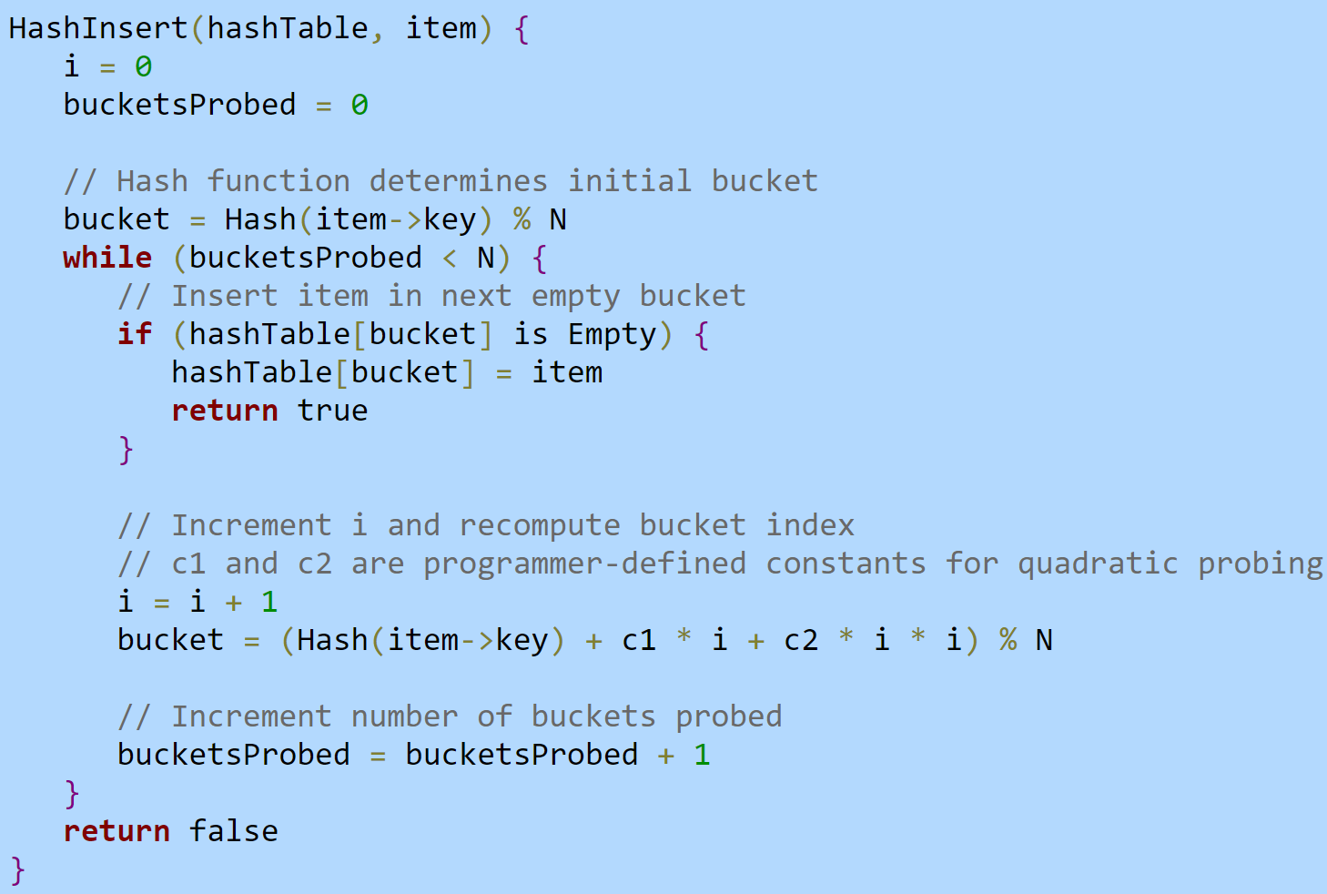
Quadratic Probing is very similar

Slide 18
Probing Performance
Linear probing
Has best cache performance because it accesses the same memory locations more frequently
Most sensitive to clustering because items get placed in buckets next to each other
Double Hashing
Has the poorest cache performance because it rarely accesses the same memory locations
Requires additional computations due to the double hash functions
Excellent at preventing clustering
Quadratic probing
Cache performance, computations, and clustering is usually somewhere in the middle between the other two techniques

Slide 19
Probing vs. Chaining Performance
Probing
Faster than Chaining when load factor is low because you don’t have to follow pointers between nodes
Gets very slow when the load factor is high because you have to search many buckets to find an open one
You can’t have more items in the table than there are buckets
Chaining
Only gets linearly slower as the load factor approaches 1 because a bucket isn’t affected by overflows from adjacent buckets
Can add more items to the table than there are buckets
Searching the lists for items can be slower than simple probing when the load factor is low

Slide 20
Hash Table Efficiency
A hash table is fast if the hash function minimizes collisions
A perfect hash function would map all items to buckets without collisions
A perfect hash function can be created if the number of items and all possible item keys are known beforehand
The runtime for insert, search, and remove is O(1) with a perfect hash function

Slide 21
Hash Table Efficiency
Having knowledge of the expected keys can help you make a more efficient hash function
Using a (key%10) hash function when the expected keys are multiples of 10 would be a bad choice
All keys would map to the same bucket
A good hash function will uniformly distribute hashed keys across all buckets

Slide 22
Common Hash Functions
Modulo hash
Key % N (where N is size of hash table)
Mid-square hash
Squares the key, extracts R digits from the result’s middle, and returns the remainder of the middle digits divided by hash table size N
For N buckets, R must be greater than or equal to log(N) to index all buckets
Multiplicative string hash
Multiplies the current hash value by a multiplier (often prime) and adds the current character’s ASCII value (repeats for each character)

Slide 23
Mid-square Hash
Example:
Hash table size of 100 (N = 100)
R = 2 (must be greater than or equal to log(N))
Key of 453
Hash function computes:
453 * 453 = 205209 (takes middle two digits since R = 2)
52 % 100 = 52
The process of squaring and extracting middle digits reduces the likelihood of keys mapping to just a few buckets

Slide 24
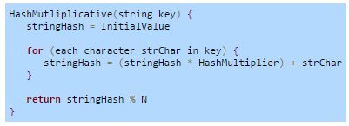
Multiplicative String Hash

Slide 25
Direct Hashing
A direct hash function uses the item’s key as the bucket index
i.e. if the key is 89, the index is 89
Called a “direct access table”
Has advantage of no collisions
Each key is unique and gets a unique bucket
No linear probing or list searching necessary

Slide 26
Direct Hashing
Limitations:
All keys must be non-negative integers
The hash table’s size equals the largest key value plus 1
This can lead to a very large table with a lot of empty buckets

Slide 27
Human Hash Table Demonstration
Main Class
Main Method
HashTable Class
HashFunction Method
Insert Method

Slide 28
Quiz This Week
Topic: Hash Tables

Slide 29
Zybooks Sections: Hash Tables
3.1 – 3.6, 3.8

Slide 30
Assignment 7 – Hash Table

